Slide 1
Rousseff Restaurant
Alessandra Conrado Velozo Igor Schneider Luiz Miranda
Comp-453 – Channah Naiman

Slide 2
Rousseff Restaurant
The mission is to serve all customers with quality, in order to provide them the best experience.

Slide 3
Objectives
Present a web application for a chain of restaurants
The application has the following functionalities:
Login
Manage restaurants, employees, customers, roles
Manage orders
Provide reports

Slide 4







Tools and Languages

Slide 5
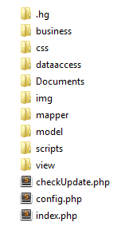
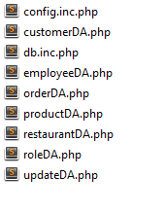
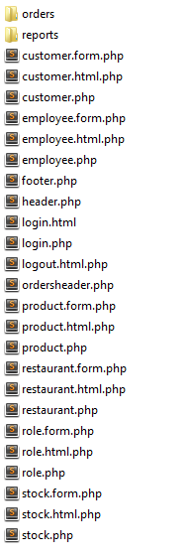
Design

Slide 6
ER Diagram

Slide 7
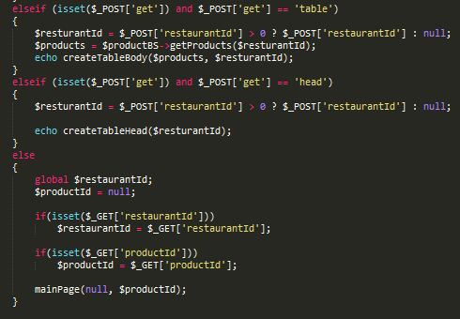
POST and GET

Slide 8
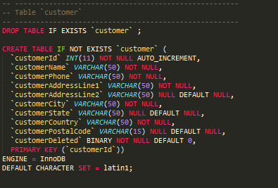
DDL

Slide 9
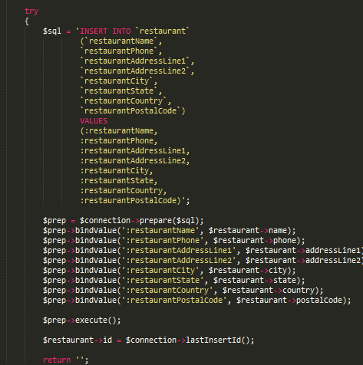
SQL Queries

Slide 10
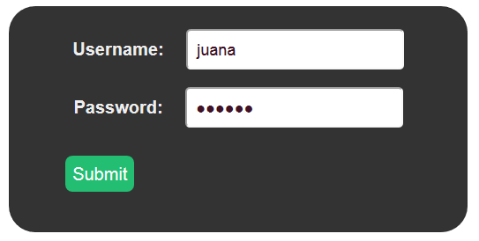
Functionalities - Login
Admin Login
Waiter Login

Slide 11
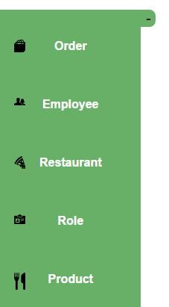
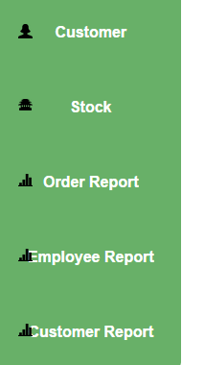
Functionalities - Admin

Slide 12
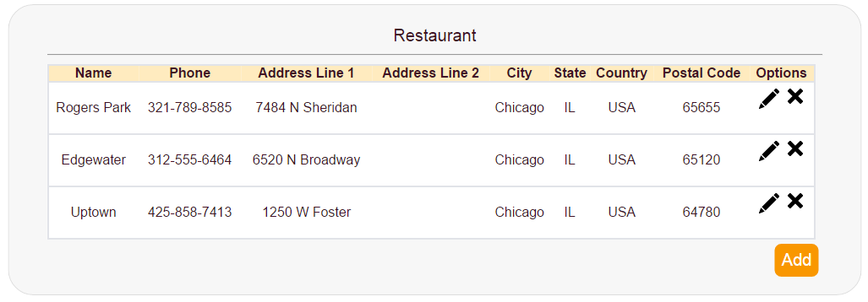
Functionalities- Admin

Slide 13
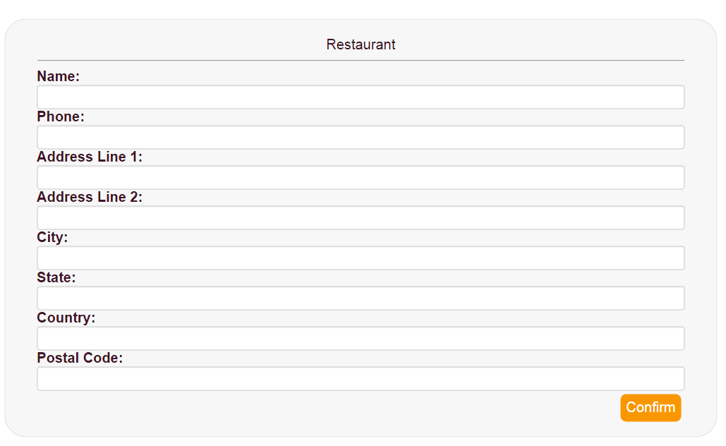
Functionalities – Admin- Add Restaurant

Slide 14
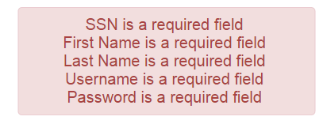
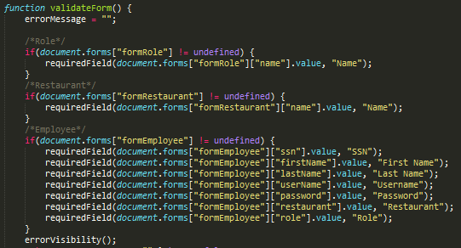
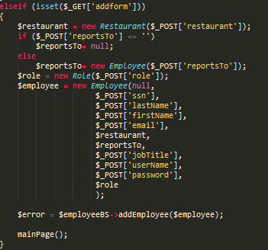
Functionalities – Validation
PHP and Javascript Validation

Slide 15
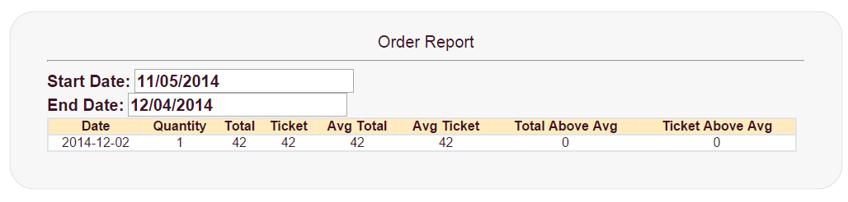
Reports

Slide 16
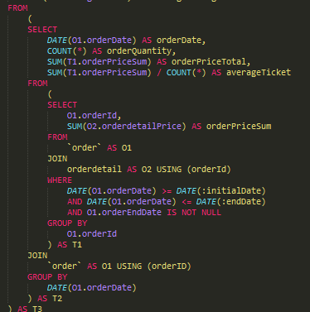
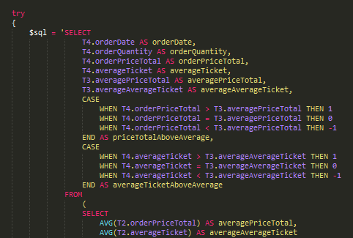

Slide 17
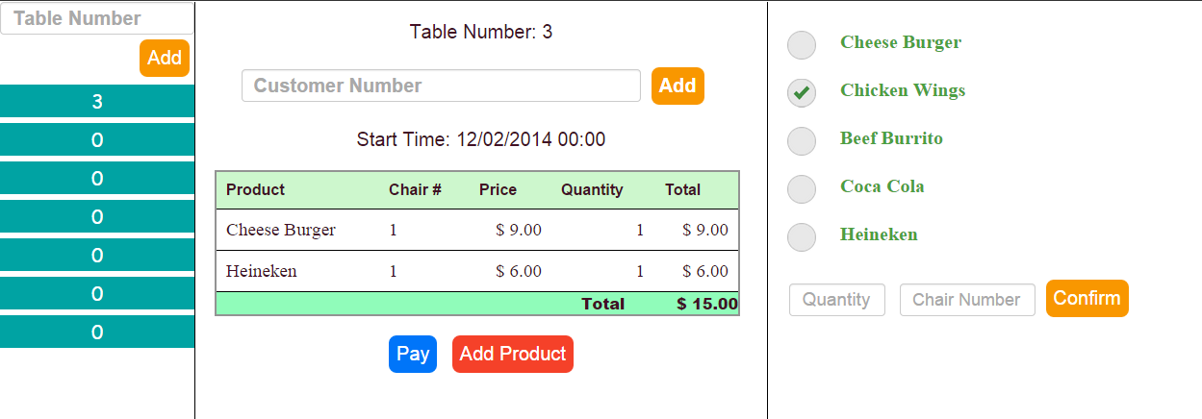
Functionalities- Operator

Slide 18
Questions

